Slide 1
capstone Framework of Events and trending exploration, extraction and learning
Joyce Lin, General assembly, data science immersive

Slide 2

On average600 tweets are tweeted per second, 350k per minute, 500 million per day.

Slide 3
objective
Twitter is mostly noise
Separating information from noise would be useful for someone to do meaningful analysis in twitter
My approach separating signal from noise is driven by identifying event related tweets from twitter streams
I found that twitter with event signals are much similar compare to non-event tweets
Using this intelligence, I build a tool that can identify event related tweets from the noise better than a simple keyword search
Additionally I also but a tool to detect trending hashtags and predict hashtag trends
Both tools work together helps a better understanding of how events unfold through twitter

Slide 4
discussion
Data was obtained using twitter streaming API specified for designated geographical area ( San Francisco, Sacremental, Los Angeles, Santa Monica, CA; Dallas, Midland, TX)
Each tweet contains original tweet url, user scream name, tweet time, location( lat/long, geo-bounding box, and/or registered city)
Tweets were simply cleaned by removing emoji and non-English words.
Extracted hashtags from each tweets and stored separately for the hashtag analysis

Slide 5
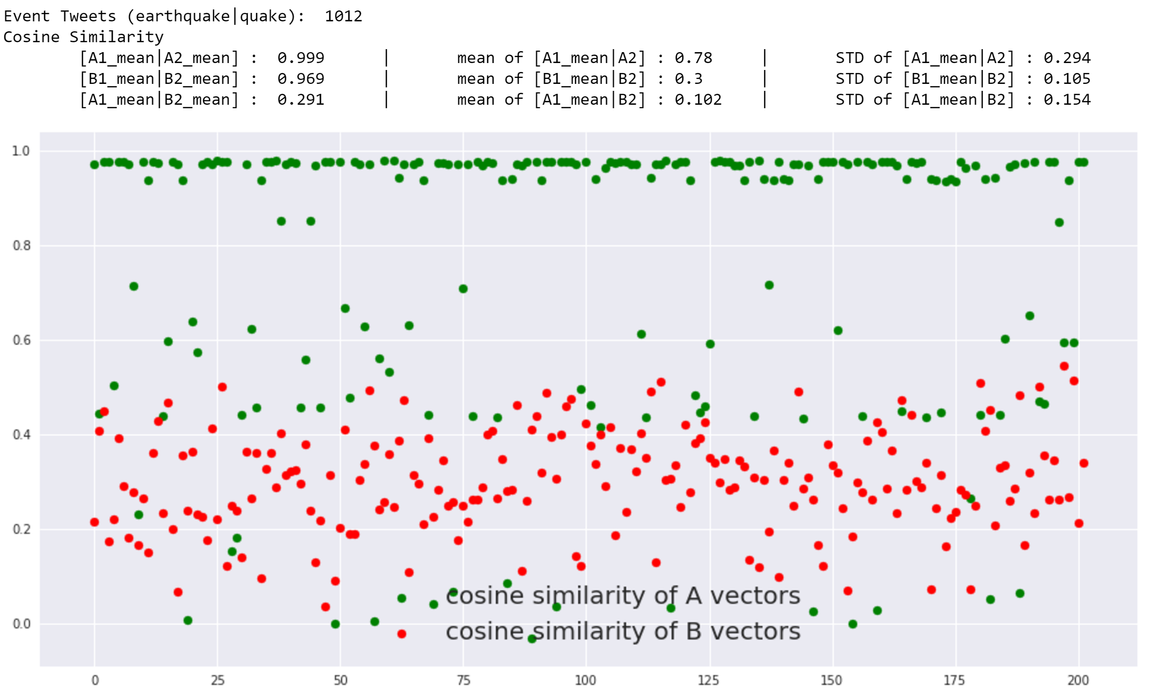

Slide 6
Future work
Implement custom Weighted Moving Average
Find optimal learning constant (alpha) for EMV

Slide 7
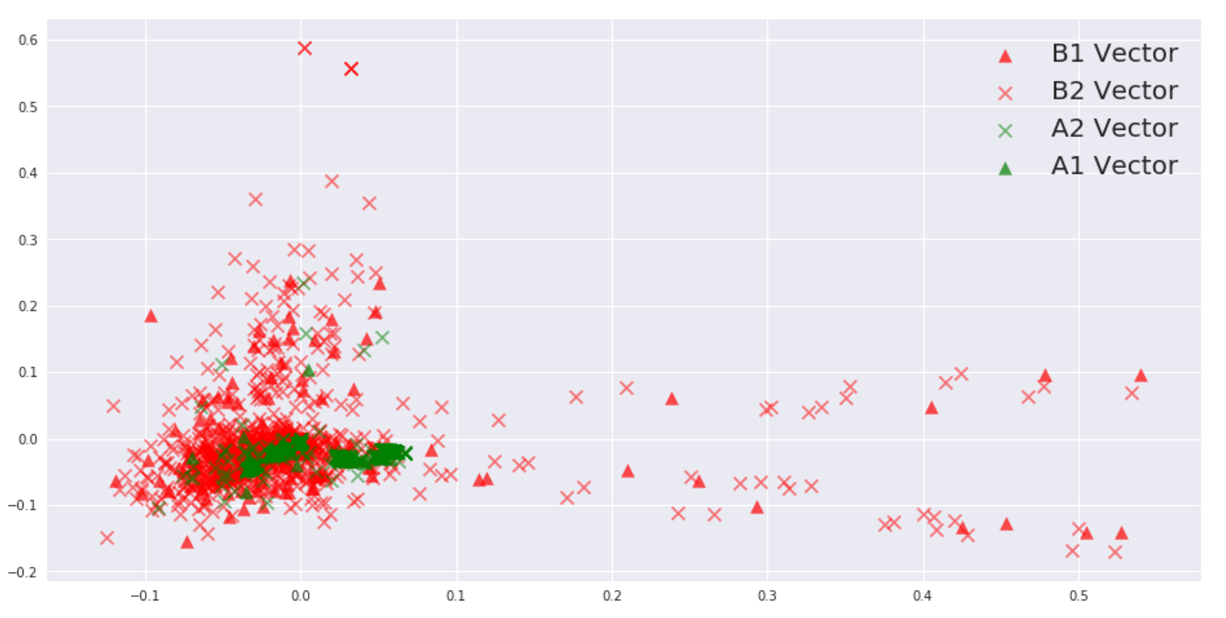

Slide 8
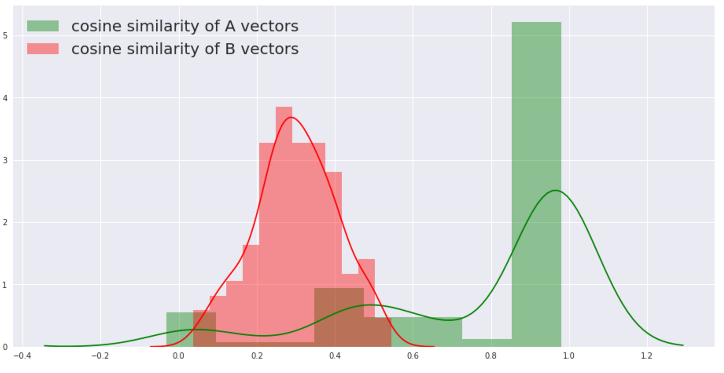

Slide 9
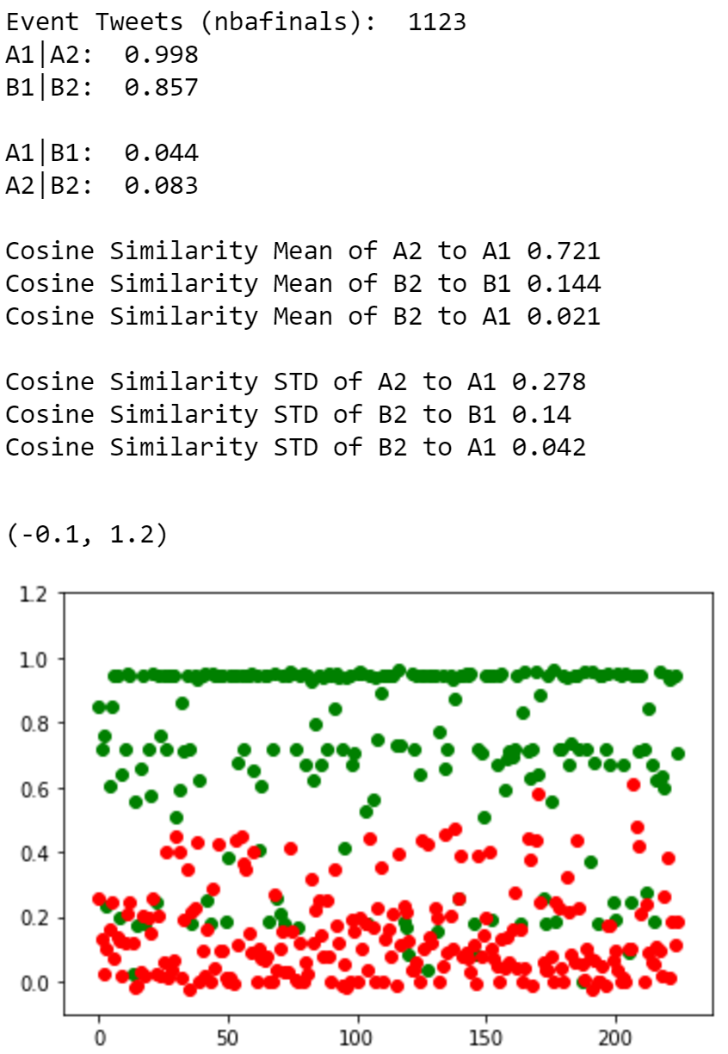
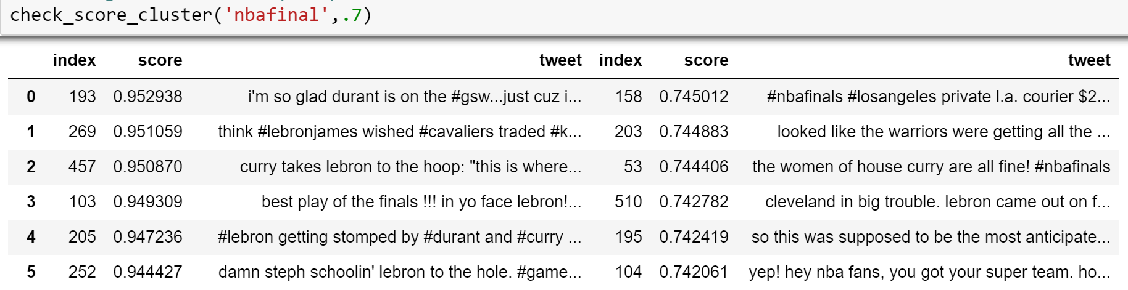
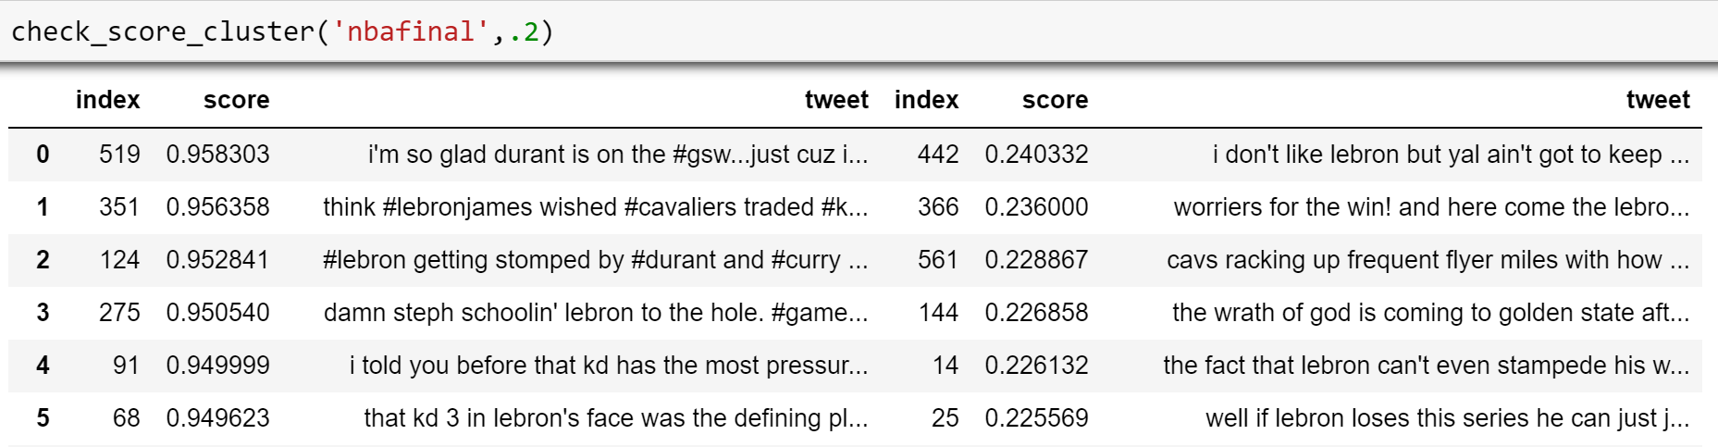
Event Identification lsa (tfidf | svd) - cosine similarity
Cosine similarity between 2 subset of event tweets (A1 | A2 )
high similarity score on
2 subset of event tweets (A1 | A2 )
Low similarity score on
2 subset of event tweets (A1 | A2 )

Slide 10
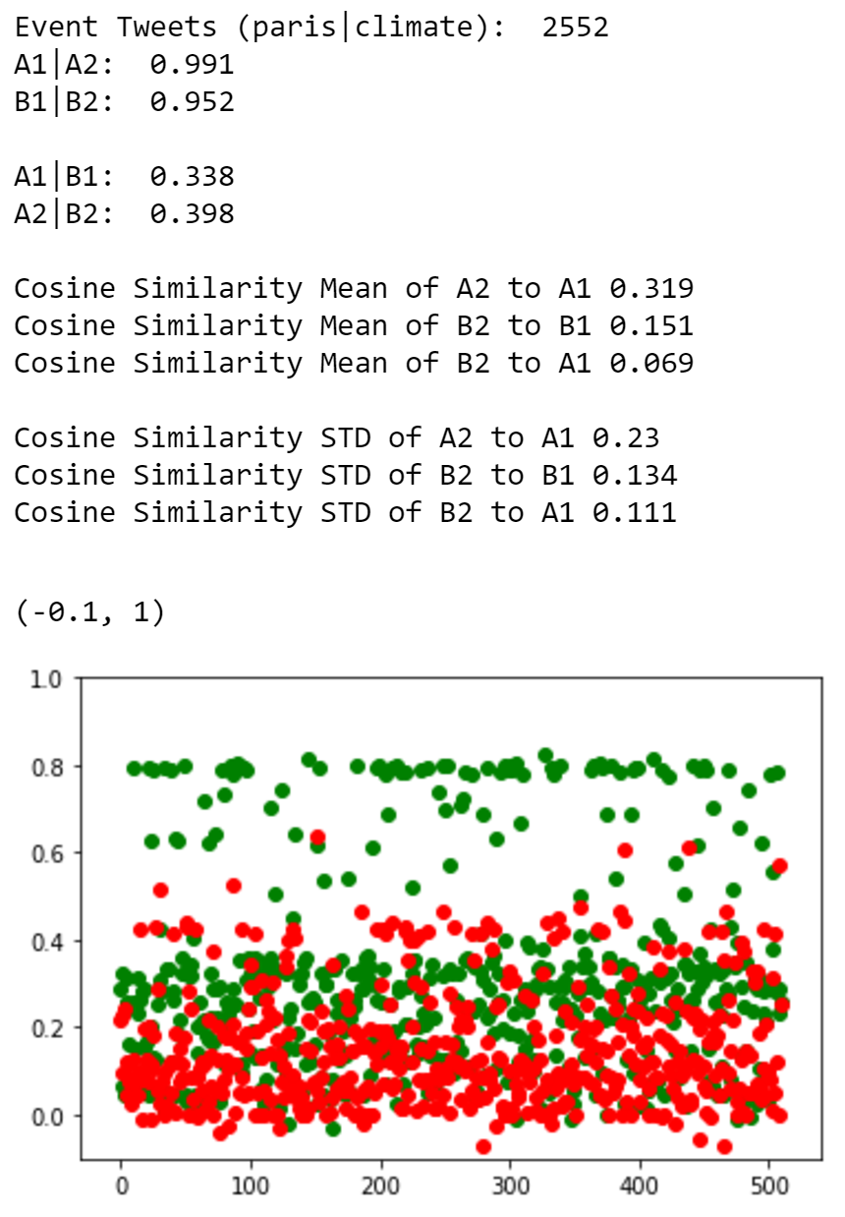
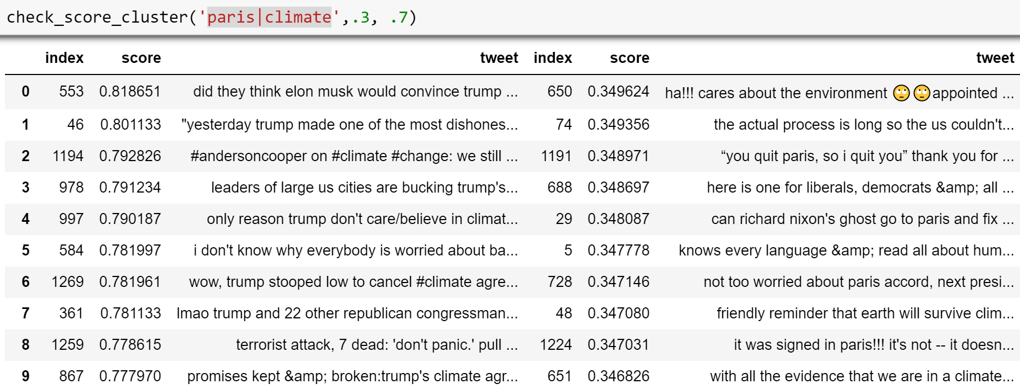
Event Identification lsa (tfidf | svd) - cosine similarity
Cosine similarity between 2 subset of event tweets (A1 | A2 )
high similarity score on
2 subset of event tweets (A1 | A2 )
Low similarity score on
2 subset of event tweets (A1 | A2 )

Slide 11
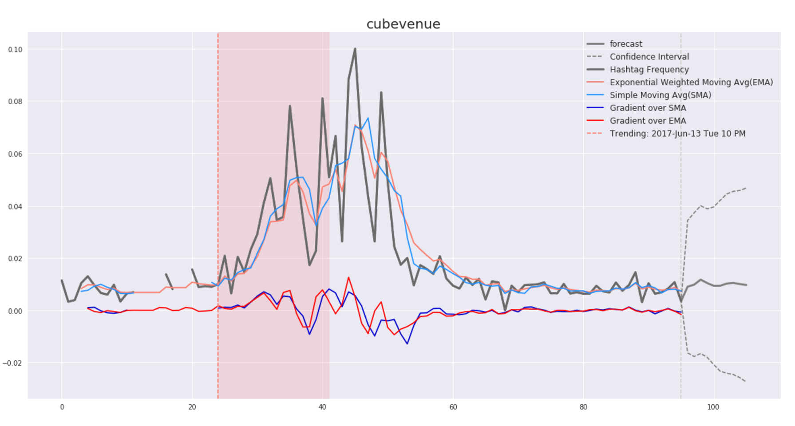

Slide 12
Implement time series analysis
Use rolling mean (moving average) to smooth out the curve
Pros: quick to compute, easy to understand, hard to go wrong
Cons: does not consider closer
Use exponential weighted moving average to smooth out the curve

Slide 13
Project pipeline
Pre Process
Vectorizing
spacy
Redis
Supervised
Decision Tree
Postgres
Pre Process
TFIDF
Pre Process
SVD(LSA)
Supervised
K Neighbor Classifier
Pre Process
Count vectorizor
Pre Process
Data Cleaning
Unsupervised
Cosine Similarity
Data Collection
From
twitter
Unsupervised
Nearest Neighbor

Slide 14
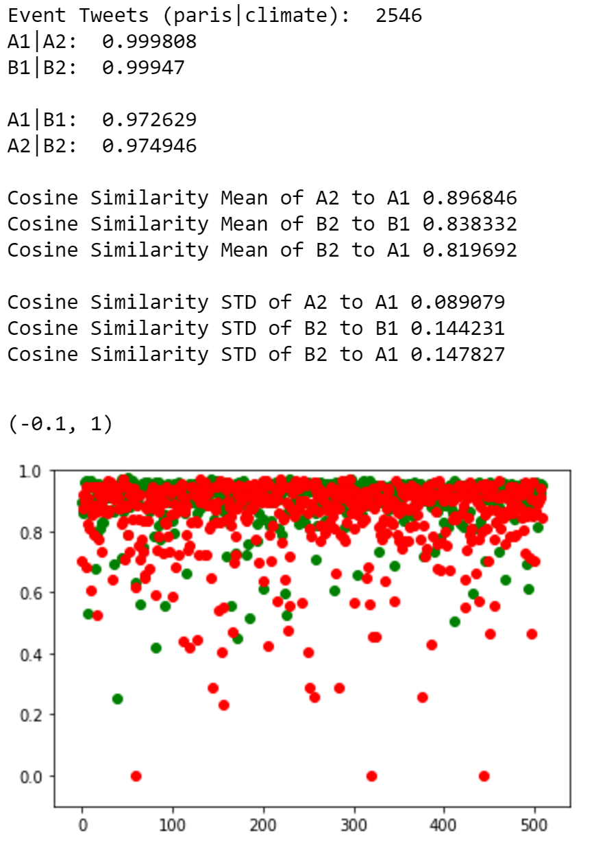
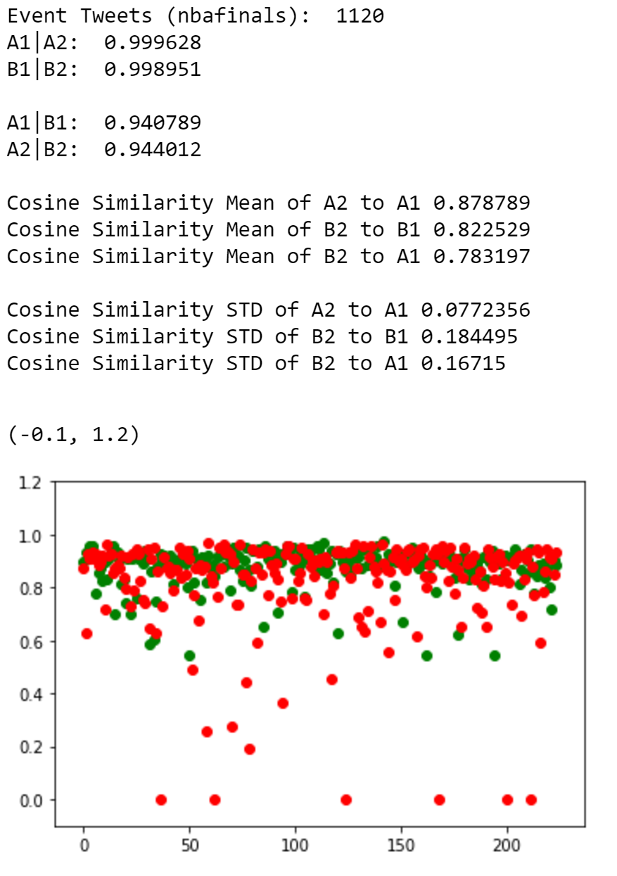
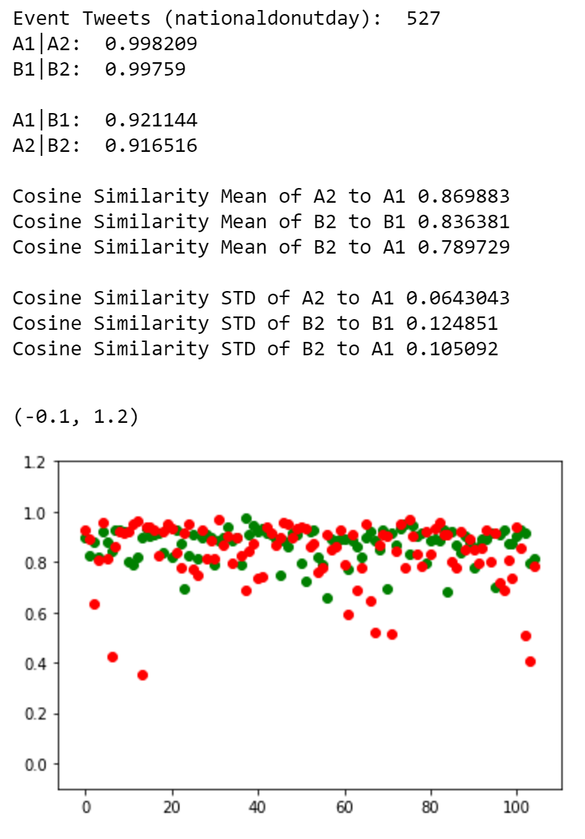
Event Identification lsa (spacy) - cosine similarity

Slide 15
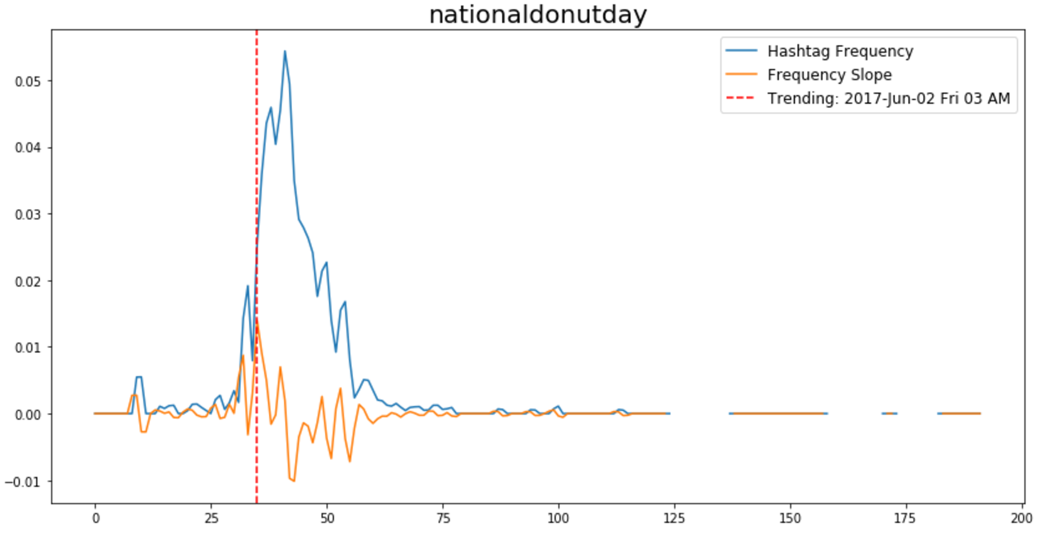
Hashtags trending using lsa count vectorizer -svd

Slide 16
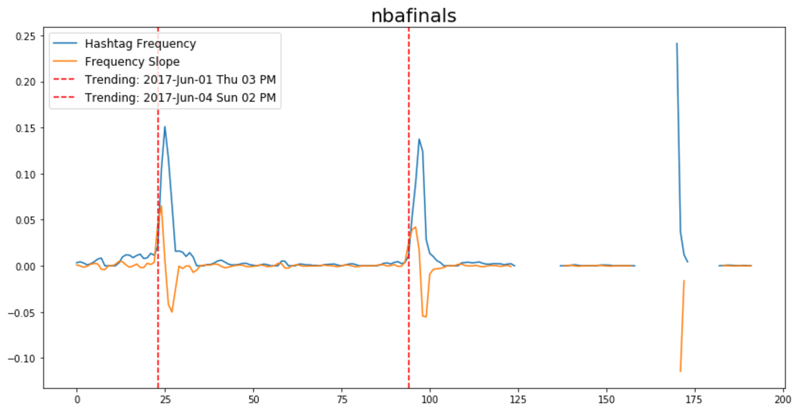
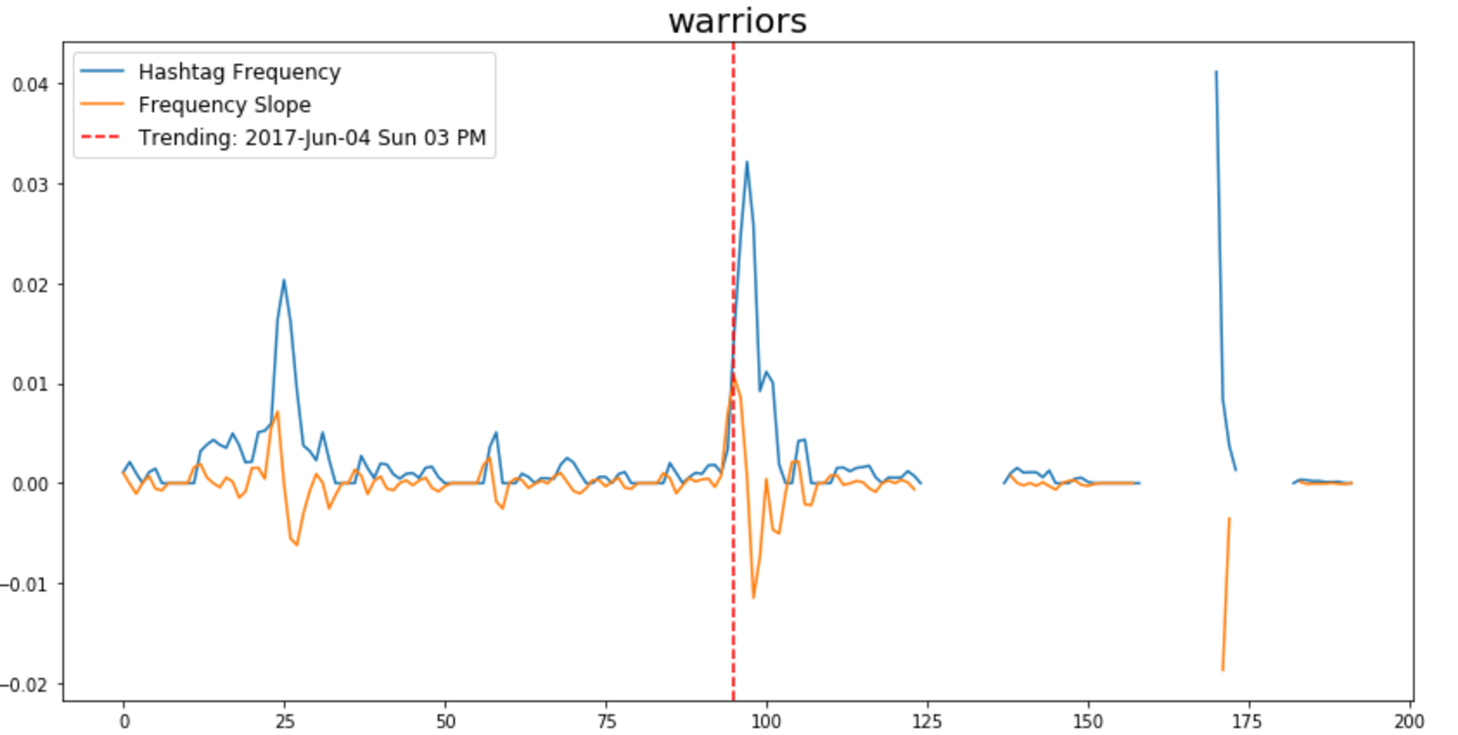
Hashtags trending using lsa count vectorizer -svd

Slide 17
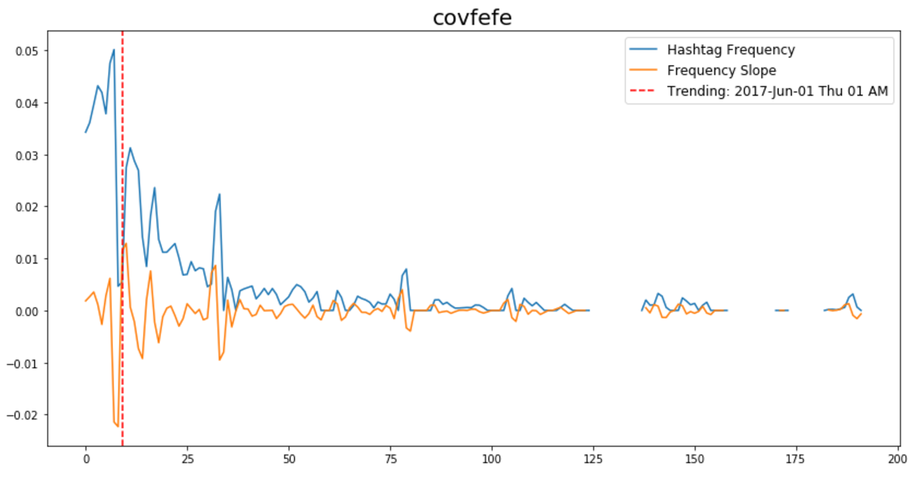
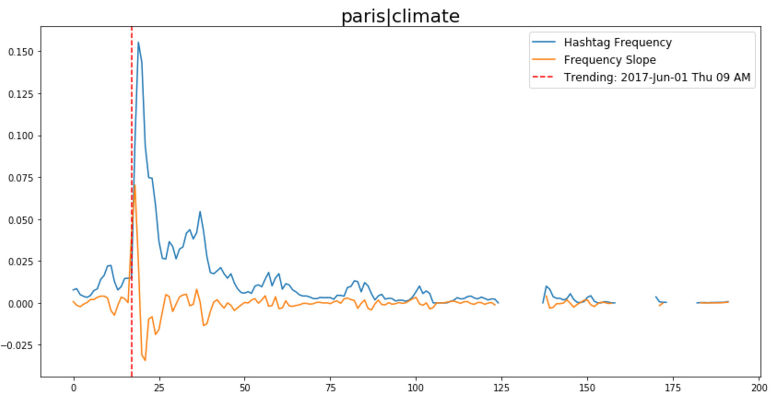
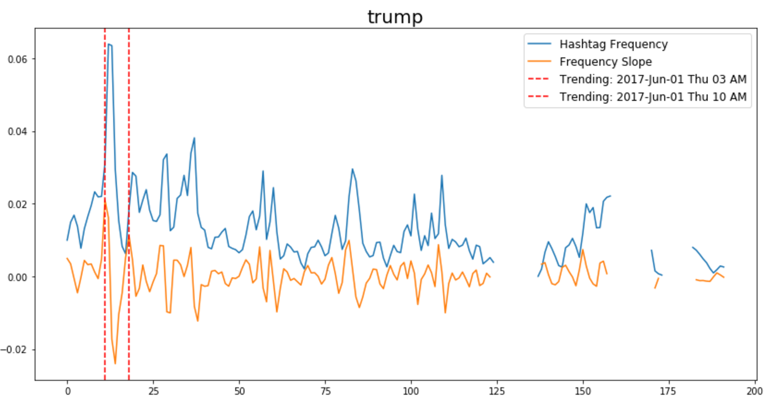
Hashtags trending using lsa count vectorizer -svd

Slide 18
Data Collection
Problems encountered:
Streaming process dies periodically due to data error.
Solutions:
Add error handling on duplicated tweets and missing features
Streaming process dies periodically due to data error.
Solutions:
Add error handling on duplicated tweets and missing features
Slow on performance.
Solutions:
Create index on often querying features
schedule reboot/ auto start docker container/ py script
Slow on performance.
Learned:
Time format/ time zone issues:
time reformat during data collection and add time zone
Minimize tweet cleaning
Tweets often contain misspells, abbreviations, emoji which are actually valuable information

Slide 19
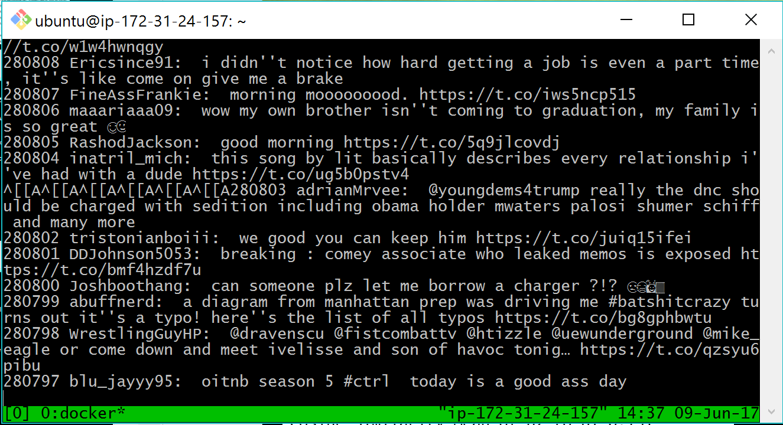

Slide 20
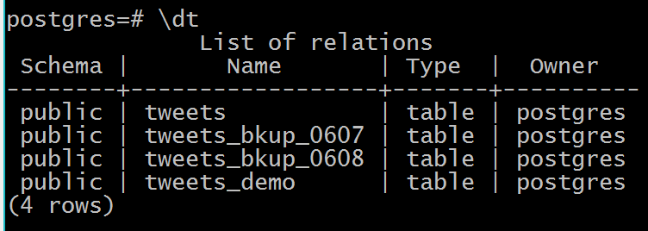
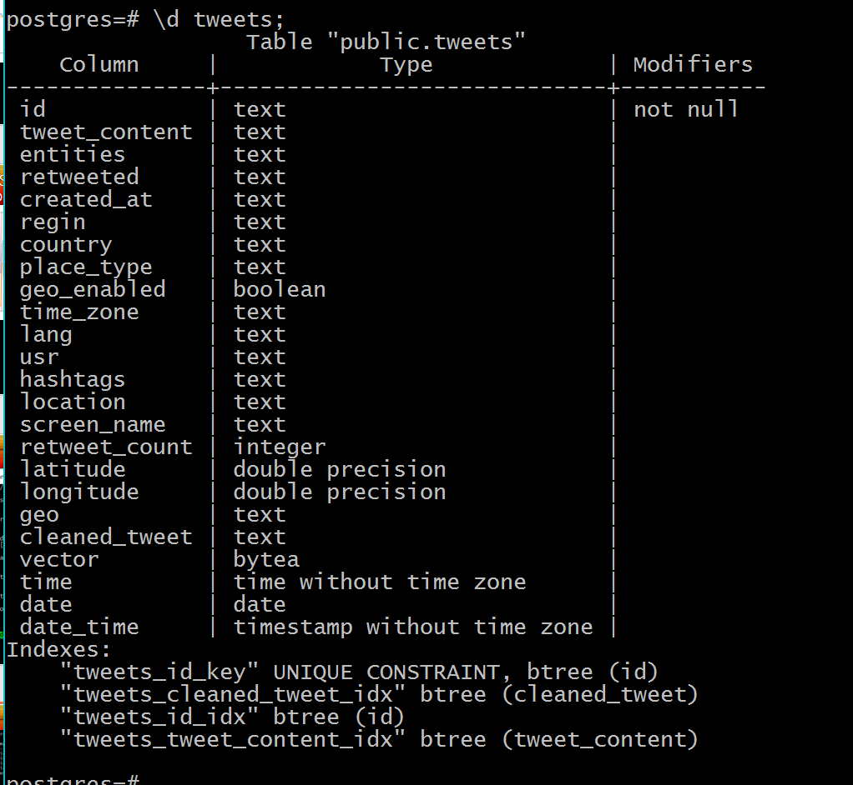
update tweets set date_time = to_timestamp(concat(substring(created_at,27,4),'-',substring(created_at,5,3),'-', substring(created_at,9,2),' ',substring(created_at,11,9)),'YYYY-Mon-DD HH24:MI:SS') at time zone 'UTC' where date_time is null;

Slide 21
Further study
Build python script for data collection
Error handing on memory issue
Further tuning on LSA n_component
Notes:
r = redis.StrictRedis(redis_ip)
r.pipeline()

Slide 22
Docker - psql
docker exec -it mypostgres psql postgres postgres
In psql
\d tweets \dt \q
select count(*) from tweets;
create able
select * into tweets_bkup_0607 from tweets;
CREATE TABLE tweets ( id TEXT, tweet_content TEXT, entities TEXT, retweeted TEXT, created_at TEXT, regin TEXT, country TEXT, place_type TEXT, geo_enabled boolean, geo text, time_zone TEXT, lang TEXT, usr text );
drop table
drop table tweets_bkup_0606;
set ID/ Index
alter table tweets alter column id set not null; alter table tweets add unique (id);
create index on tweets (id); create index on tweets (tweet_content);
clean table
select count () from tweets where hashtags = 'None’;
select count () from tweets where hashtags is null; update tweets set hashtags = NULL where hashtags = 'None';
select count(*) from tweets where lang != 'en’;
delete from tweets where lang != 'en’;
update tweets set hashtags = null where hashtags = 'None'
get cloumns
SELECT * FROM Northwind.INFORMATION_SCHEMA.COLUMNS WHERE TABLE_NAME = 'tweets';

Slide 23
select created_at, concat(substring(created_at,27,4),'-',substring(created_at,5,3),'-',substring(created_at,9,2)) from tweets limit 1;
update tweets set time = TO_TIMESTAMP(substring(created_at,11,9), 'HH24:MI:SS') where time is null;
update tweets set date = TO_date(concat(substring(created_at,27,4),'-',substring(created_at,5,3),'-',substring(created_at,9,2)), 'YYYY-Mon-DD') where date is null;
update tweets set date_time = to_timestamp(concat(substring(created_at,27,4),'-',substring(created_at,5,3),'-', substring(created_at,9,2),' ',substring(created_at,11,9)),'YYYY-Mon-DD HH24:MI:SS') at time zone 'UTC' where date_time is null;

Slide 24
Data Collection
Used Twitter Streaming python API to stream tweets based on geographical boundary boxes
Time Period: 5/30/2017 – present with few hours down time
Locations:
Santa Monica, Los Angeles, San Francisco, Sacramento, CA
Dallas, Midland, TX
Set up Postgres for data repository
Currently contains 450k tweets
Data Processing during collection:
Basic cleaning on tweets:
Remove people tags
Remove web url
Removed non-English tweets from the collection
Extract hashtag keywords

Slide 25
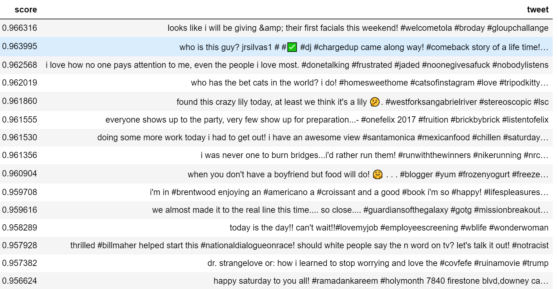
Event Identification lsa (spacy) - cosine similarity

Slide 26
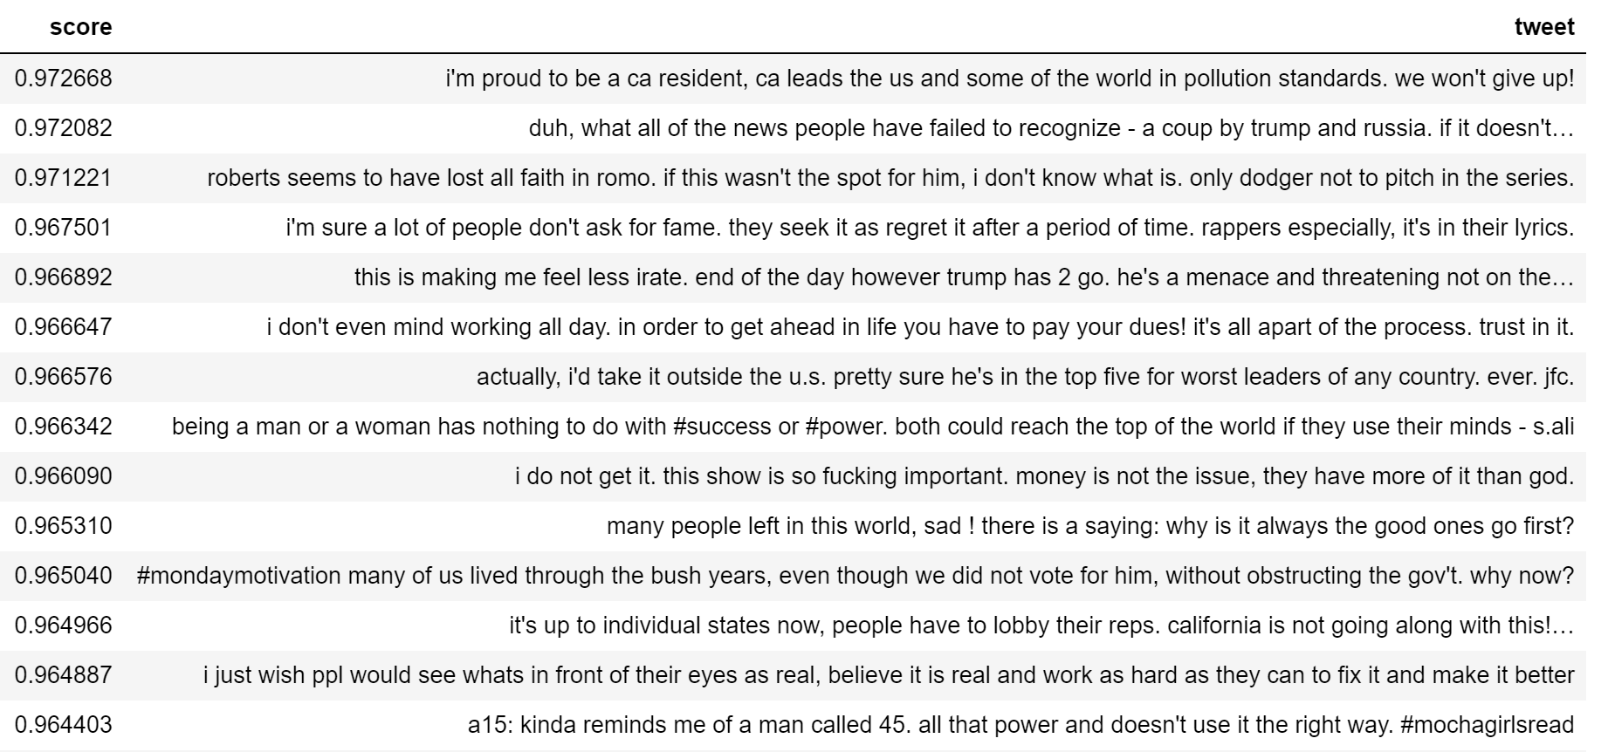
Event Identification lsa (spacy) - cosine similarity

Slide 27
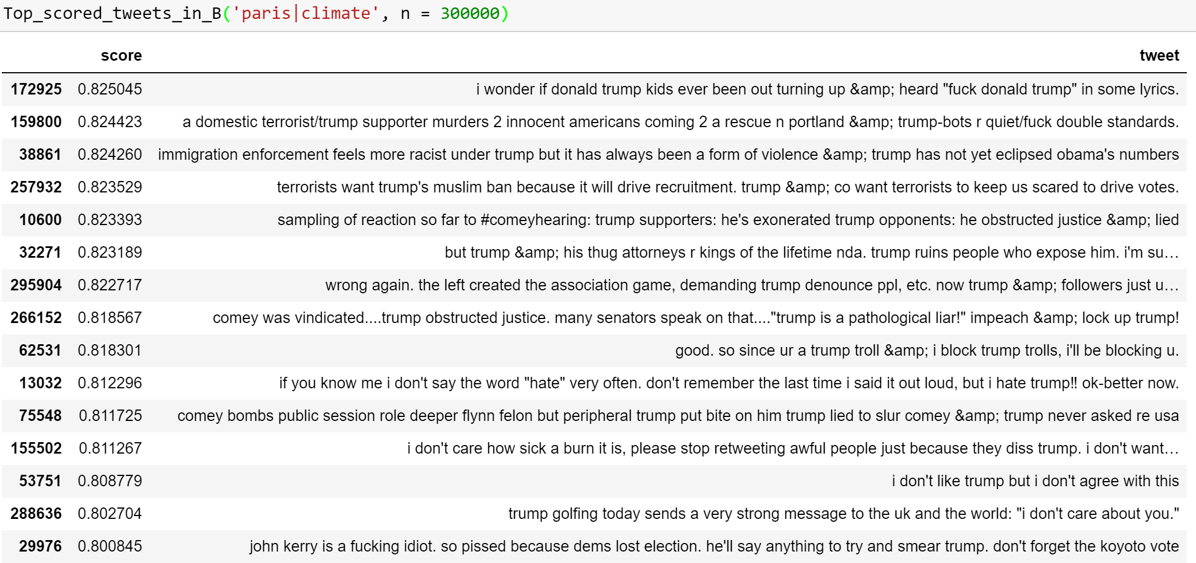
Event Identification lsa (tfidf | svd) - cosine similarity
Cosine similarity between event / non-event tweets (A | B )
Highest similarity score on event tweets / non-event tweets (A | B )

Slide 28
Event Identification lsa (tfidf | svd) - cosine similarity
User sklearn Tfidf to fit and transform all collected tweets (cleaned) into counted bag of words
Fit full dataset with SVD model
For selected events split into A (event tweets), B (non-event tweets)
Create subset of A1 (20% of A), A2 (80% of A)
Create random subset of B1 ( # of A1 in B), B2( # of A2 in B)
Run cosine similarity analysis on to the 4 groups
Problems encountered:
RAM issue on transforming full dataset using SVD

Slide 29
Hashtags trending using lsa count vectorizer -svd
User sklearn CountVectorizer to fit and transform all collected hashtags into counted bag of words
Bucket tweets into moving time blocks
Time lag = 6 hours
Time gap for each moving block: 2 hours
Run time series analysis on selected hashtag for trending during collected time frame
Problems encountered:
Memory issue

